Slide 1
< Insert organization / college logo > Welcome < Enter the Session title > Hosted by <name or organizaton> Presented by < presenter name> Telephone access: < enter the tel # > Passcode: < enter the code >
Housekeeping Slides
Use these housekeeping slides to give instruction to your participants about participating in your meeting.
Select the slides that are appropriate to your meeting, and edit as needed.

Slide 2
If you are listening over your computer, adjust the volume with the sliders.
Audio Listening
If you are listening over the telephone, click the telephone handset.

Slide 3
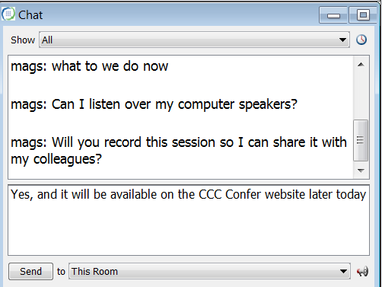
Send Text Chat Messages
Type your message in this area, then click Send to deliver the message to everyone.

Slide 4
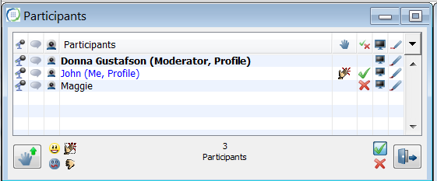
Raise Your Hand Express Your Thoughts Respond to a Poll or Question
Raise or lower your hand.
Respond to a poll or question.
Express your thoughts with emoticons!

Slide 5
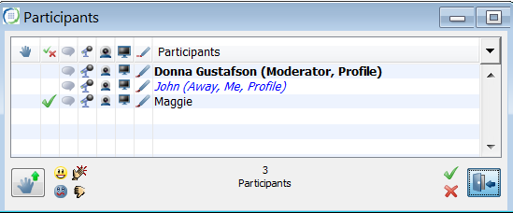
Step Away and Return
If you need to leave the meeting for a moment – let us know you are not participating at this time.
Step Away and Return
Click once to “Step Away”
Click again to “Return”

Slide 6
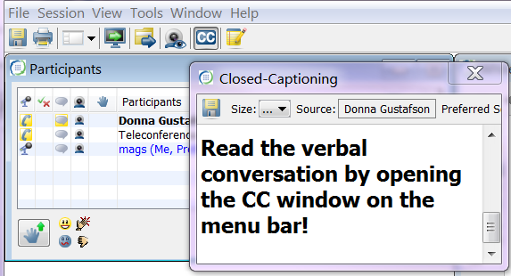
View Closed Captions
Click to open the Closed-Caption window.

Slide 7
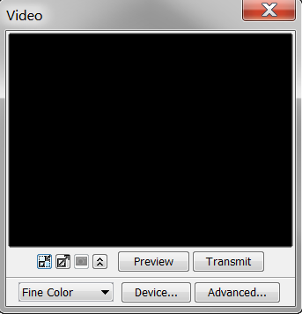
Adjust the Video
Adjust the size of the video window.
Change between gray and color view.

